Slide 3
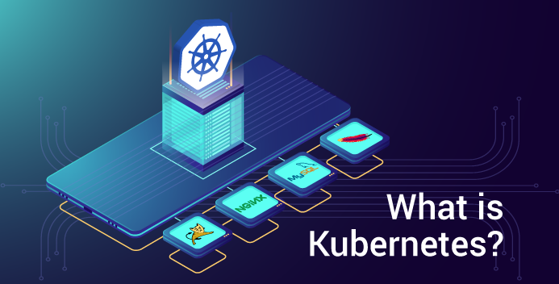

Slide 4
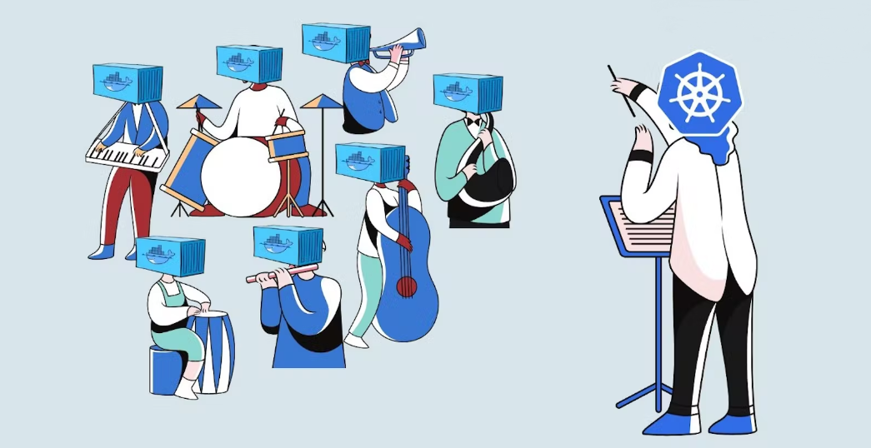
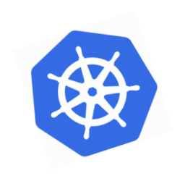
Kubernetes is an open-source container orchestration system for automating software deployment, scaling, and management.
google made kubernates open source and 2014 donated it to CNCF organization.
orchestration management

Slide 5
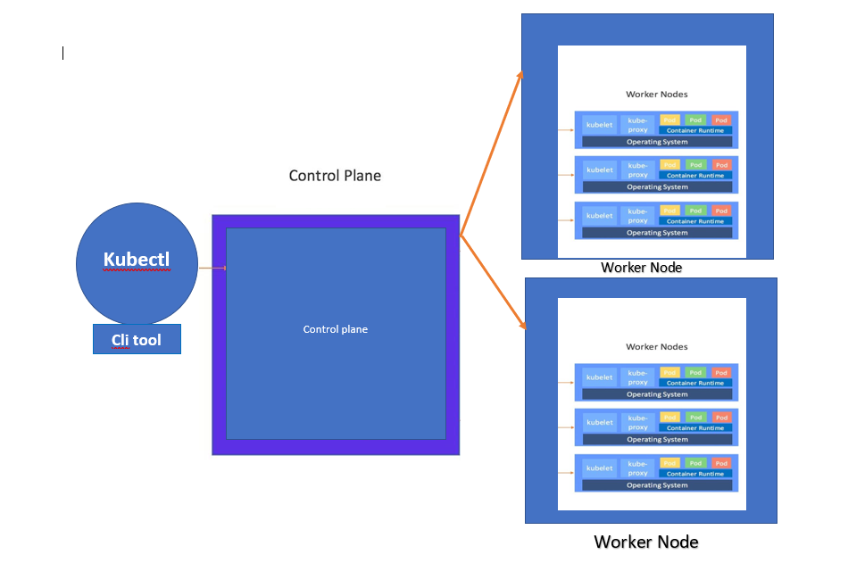

Slide 6
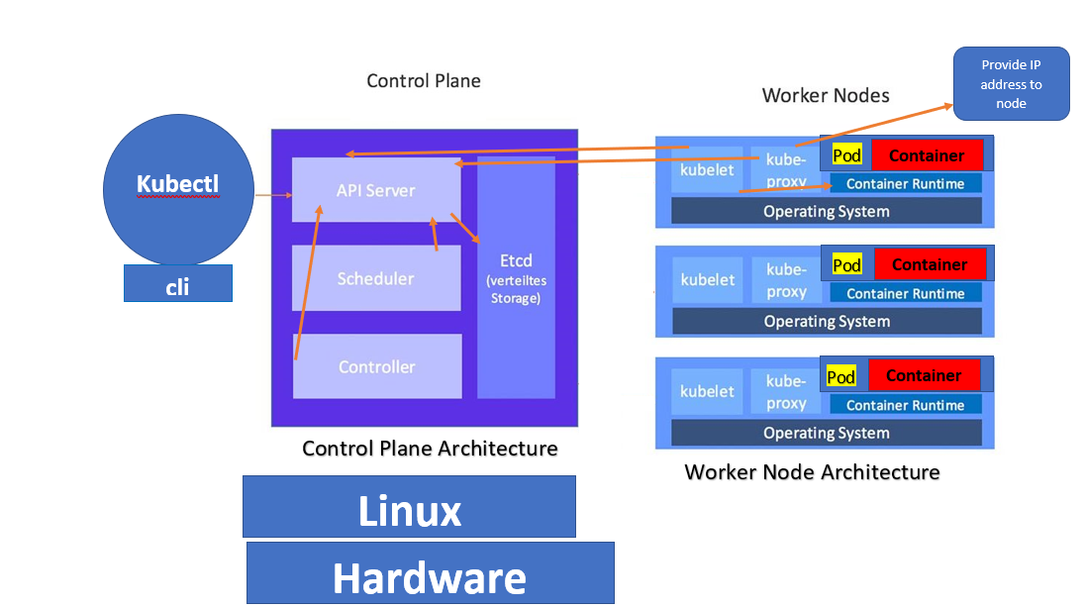

Slide 7
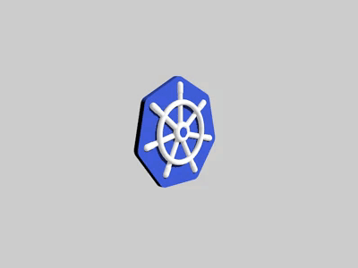
Advantage of k8s
Running on it own cloud, or in own machine or outside of public cloud provider as well.
You can easily migrate it one provider to another provider
you can also manage to scale, replicate, deployment, fault tolerance, zero downtime, self healing clusters, also load balancing and request & stuffs.

Slide 8


Slide 9
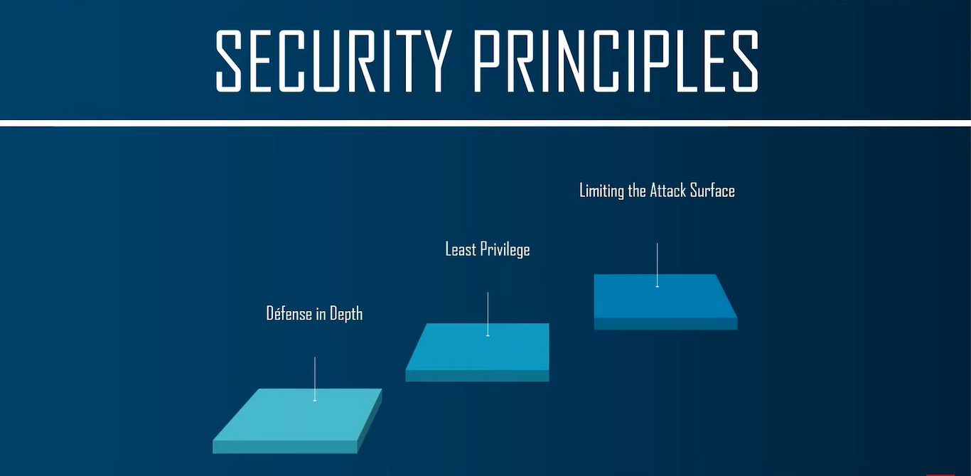


Slide 10
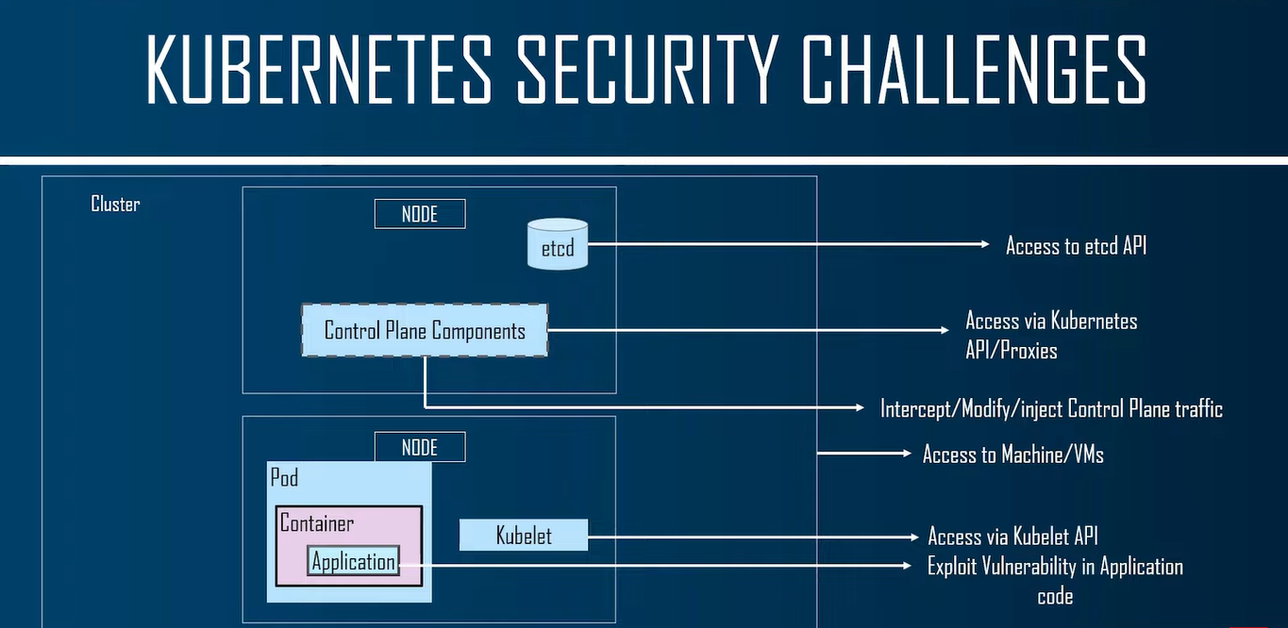

Slide 11
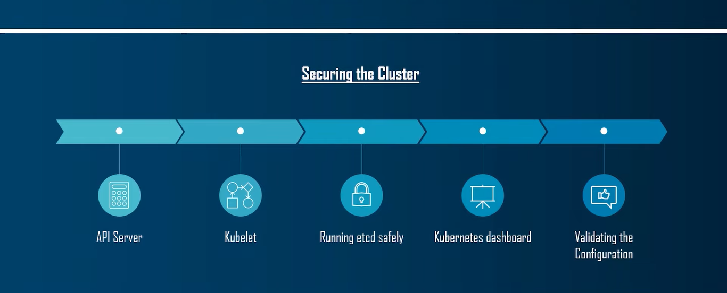

Slide 12
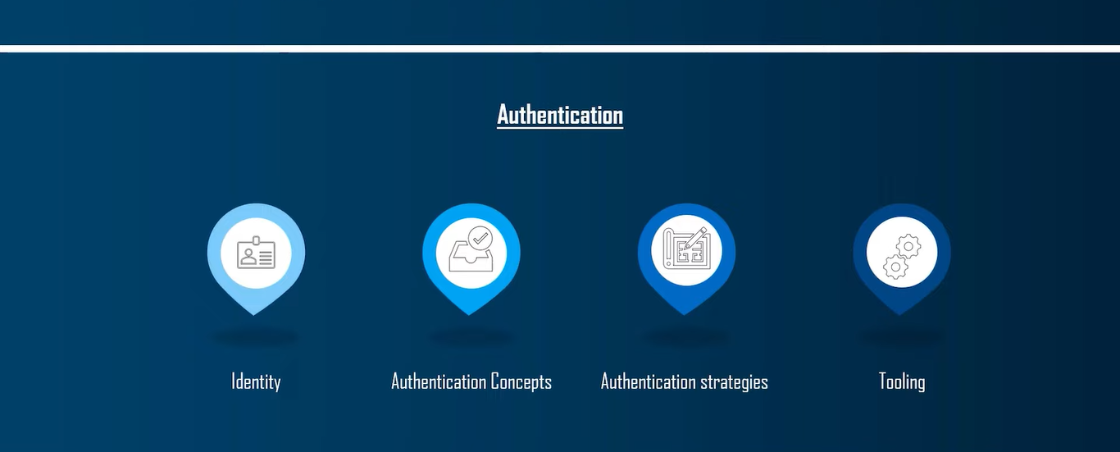

Slide 13
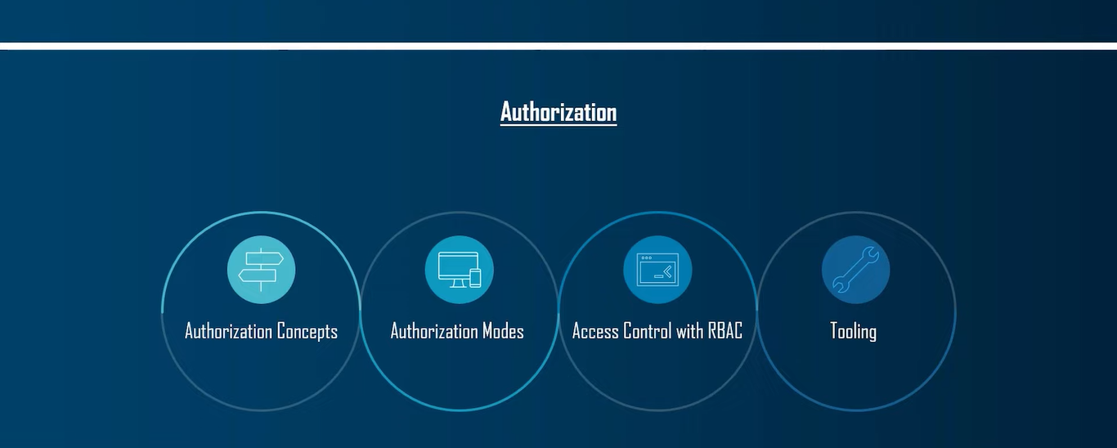

Slide 14
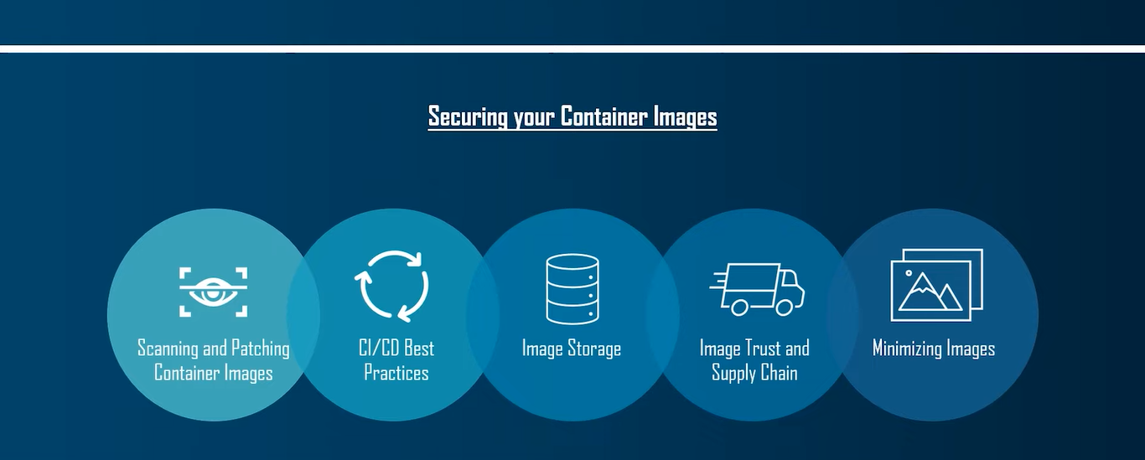

Slide 15
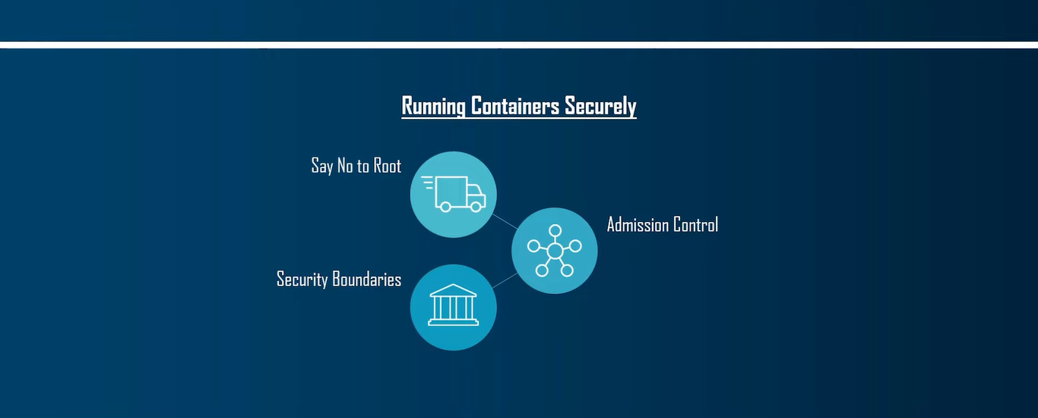

Slide 16
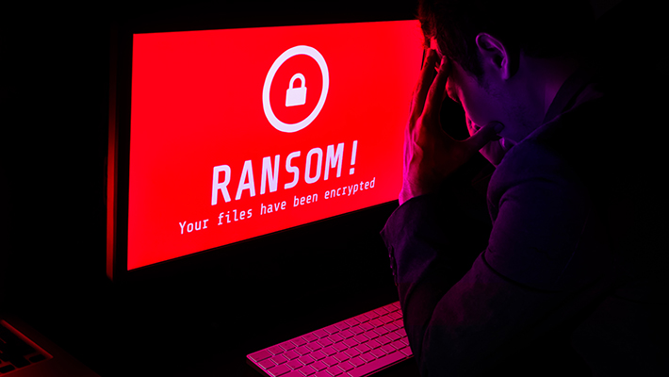
what is ransomware

Slide 17
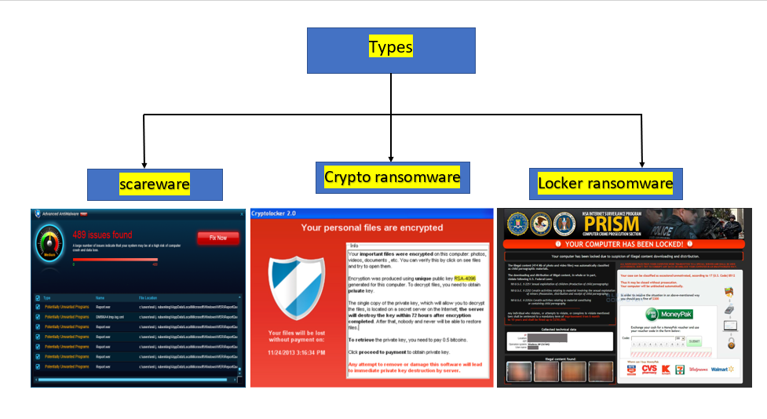
Types of Ransomware

Slide 18
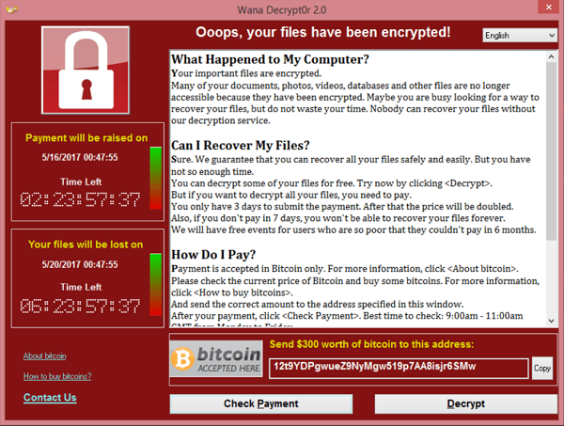

Slide 19
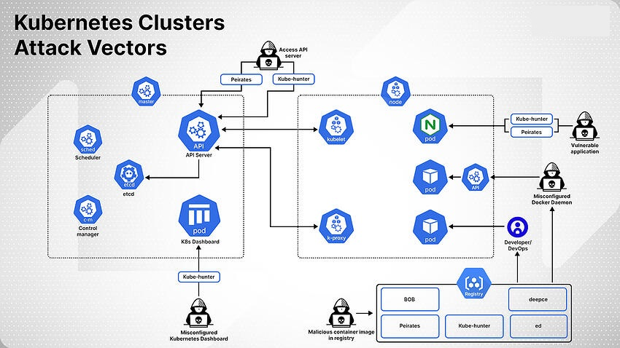
How it is effect my local system

Slide 20
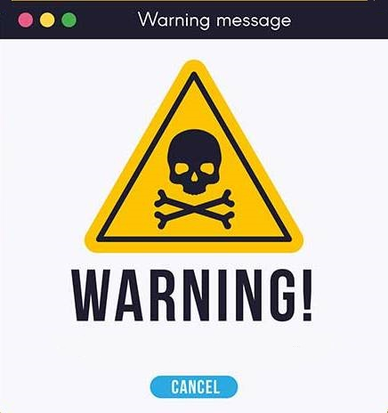
How to dected ransomware
There are many levels of security that kubernates manage. Each component of kubernates has it's own security level like firewall rule, policies, and user permission.
In kubernates pods, nodes, & the servers also have different security measures and policies that can easily detect unwanted & unnecessary traffic in the network.
There are lots of anti virus that keep a catalog of all the known threats, so they can identify ransomware quickly and effectively. Some antivirus apps also provide a free ransomware decryption tool for malware with low-level encryption.

Slide 21
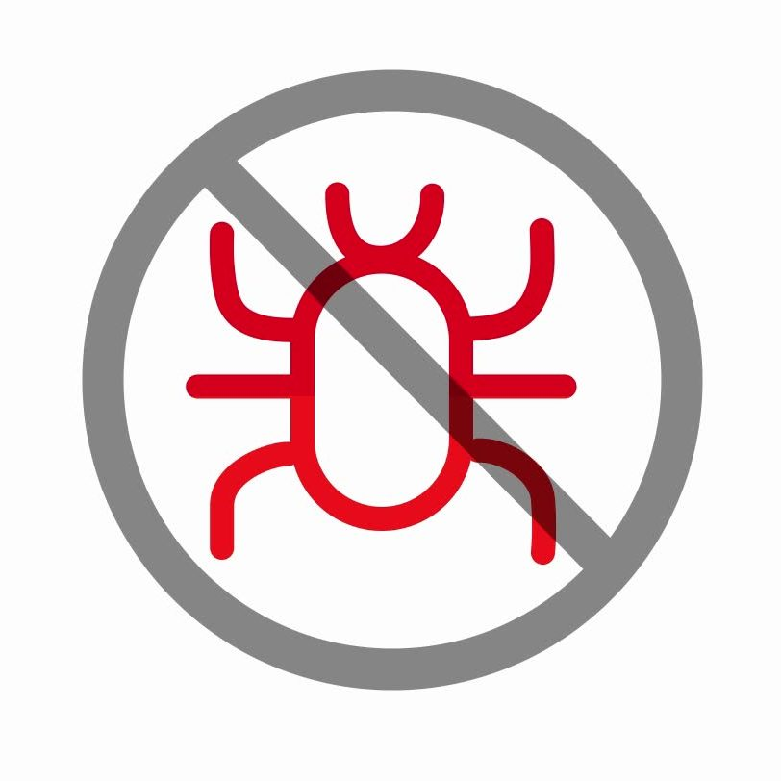
How to prevent ransomware
Update your software and operating system regularly
Do not click on suspicious links
Never open untrusted email attachments
Do not download from untrusted websites
Avoid unknown USBs
Use a VPN when using public Wi-Fi
Install internet security software
Update your internet security software

Slide 22
Thank You

Slide 23
A container image represents binary data that encapsulates an application and all its software dependencies. Container images are executable software bundles that can run standalone and that make very well defined assumptions about their runtime environment.

Slide 24
How these malicious container images strike:
The Container image entrypoint is set to execute DEEPCE, an Offensive Security Tool (OST) designed to attempt escaping the containerized environment and taking a hold of the host, which means this container image is designed to run in the target’s environment. The image also contains other OSTs that allow the attacker to conduct further malicious attacks against Kubernetes clusters, such as detecting vulnerabilities in API server, pods, kublet API, Docker API, Docker.sock, etc.

Slide 25
Initial access:
The tools in this container image (‘bobedpei’) can detect possible initial access points:
Misconfigured ports that enable anybody to write commands to the APIs. These tools scan default ports to identify any misconfigurations. For instance, open to the world Docker API running on port 2375, or misconfigured etcd API on port 2379.
Misconfigured K8s Dashboard enables unauthenticated login.
Misconfigured K8s API Server enables unauthenticated login.
Misconfigured etcd database enables anyone to make actions in the database. For instance, allowing Read and Write to etcd DB.
In addition to allowing initial access, this container image (‘bobedpei’) enables extensive discovery possibilities:
K8s Dashboard
K8s API Server
K8s etcd
K8s pods
Docker Socket
Collecting information about container files, network, and interfaces, which can be further exploited for credential theft
Network Scanning
Provides Metadata (i.e., AWS, GCP)

